Slide 1

Summer Olympics - EDA
Presented By
Sathish Kumar Venugopal Nov’19

Slide 2
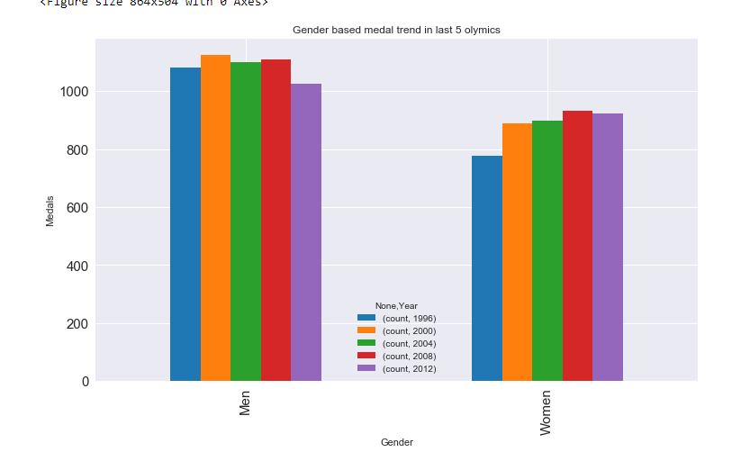
Gender wise Medal Trend
Men's Medal Trends
Men's getting medals are fluctuating in the last 5 Years
Women's Medal Trends
Women's getting medals has constantly increased in last 5 Olympics (Except in 2012)

Slide 3
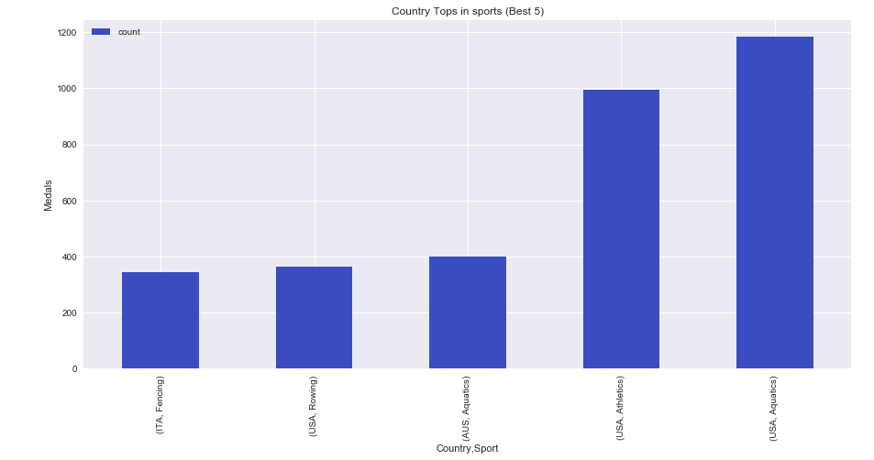
Which Country Tops is which Sports
US has a strong medal winning trend in Aquatics Sports

Slide 4
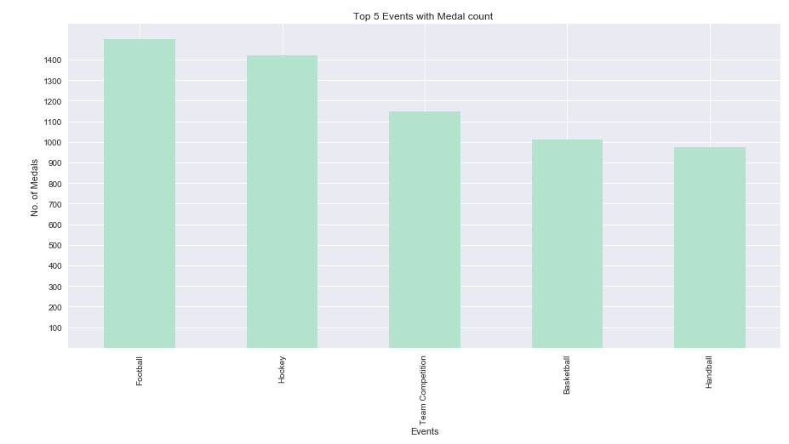
Top 5 Events with Medal Counts
Football Event was most dominating Event in Olympics

Slide 5
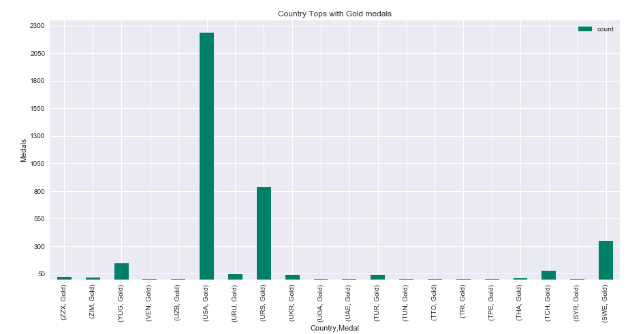
Which Country got how many “Gold” medals in all the Olympics
US has got maximum no. of Gold in all the Olympics
US got 3 times more gold then its successor USR

Slide 6
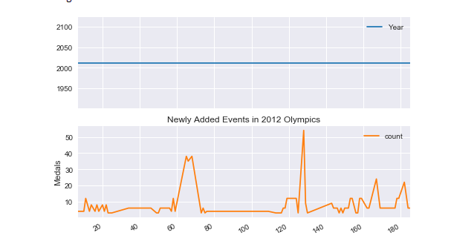
Newly Added Events with Medal count (2012)
Around 90 new events has been introduced in 2012

Slide 7
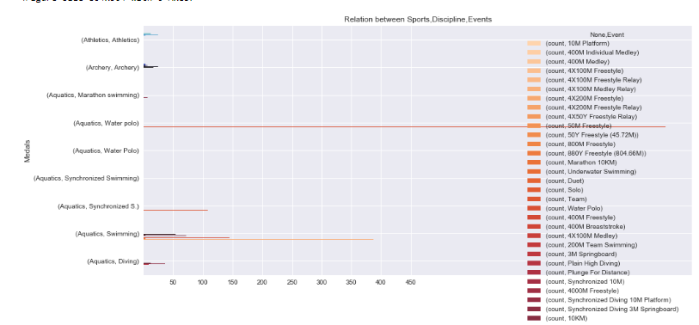
Finding Relation between Sports, Discipline & Event
Aquatics has more no. of Discipline and Events

